Slide 1
Annual Tuberculosis (TB) Education
RiteChoice Hospice
LivinRite Home Health Services
RiteChoice Caregiving Solutions

Slide 2
Overview
Tuberculosis Disease vs. Latent Tuberculosis Infection
Risk Assessment, Screening and Testing
TB Transmission
Infection Control
TB Symptoms
TB Testing
LTBI Treatment

Slide 3
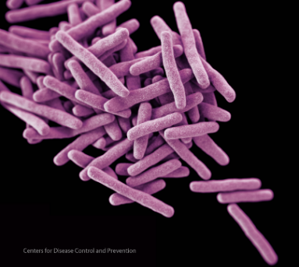

Tuberculosis
Tuberculosis (TB) is caused by a bacterium called Mycobacterium tuberculosis.
The bacteria usually attack the lungs, but TB bacteria can attack any part of the body.
Not everyone infected with TB bacteria becomes sick.
Latent TB infection (LTBI)
TB disease

Slide 4
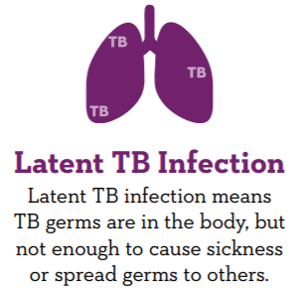
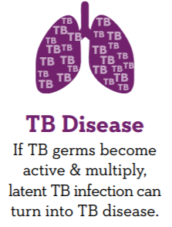
LTBI vs. TB Disease
Notes:
Latent TB Infection, or LTBI, means that TB germs are in the body, but not enough to cause sickness or spread germs to others. In some countries, this is referred to as “sleeping TB”. A person with LTBI does not have symptoms.
LTBI can progress to TB disease if the TB germs become active and multiply. Someone with TB disease in the lungs or larynx can infect others.

Slide 5
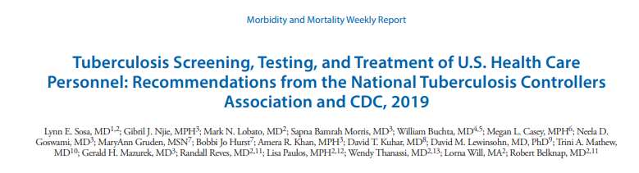
TB Screening, Testing and Treatment of U.S. Healthcare Personnel
Updated guidance released in May of 2019 to supplement the 2005 guidelines for preventing the transmission of Mycobacterium tuberculosis in healthcare settings
Notes:
In 2019, updated guidance was released surrounding TB Screening, Testing and Treatment of U.S. Healthcare Personnel (HCP). This updated guidance is based on a systematic review of TB surveillance data and of HCP screening data. Rates of TB in the U.S. have been in decline since 1991, including among HCP. The review also found a low percentage of HCP have a positive TB test at baseline and upon serial testing. Serial testing has limitations in populations at low risk.
Annual TB testing of health care personnel is not recommended unless there is a known exposure or ongoing transmission at a healthcare facility. Health care personnel with untreated latent TB infection should receive an annual TB symptom screen.
Healthcare facilities might consider using annual TB screening for certain groups at increased occupational risk for TB exposure (e.g., pulmonologists or respiratory therapists) or in certain settings if transmission has occurred in the past (e.g., emergency departments).
All health care personnel should receive TB education annually, which is why we are here today.

Slide 6
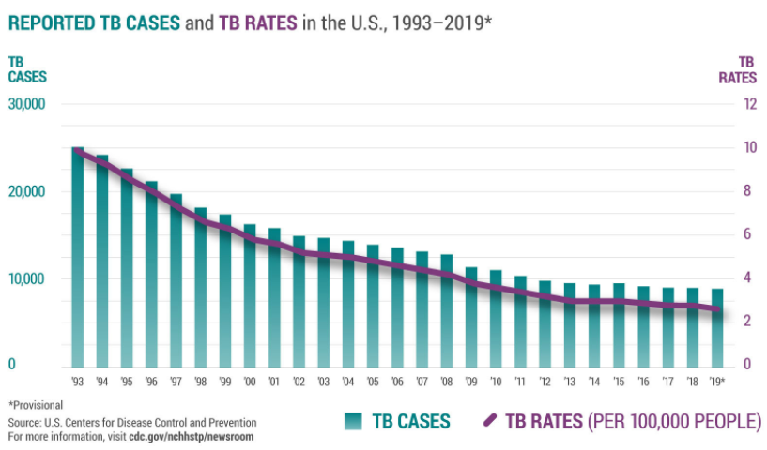
TB in the United States
Notes:
Here you can see the decline in U.S. TB cases and rates since the early 1990s. (TB cases = active TB disease)

Slide 7
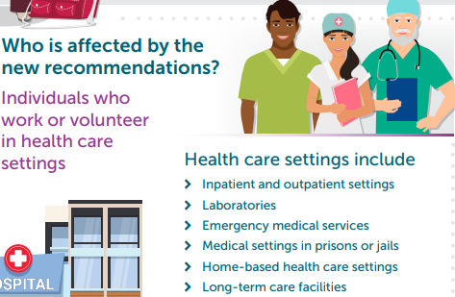
TB Screening, Testing and Treatment of U.S. Healthcare Personnel
Notes:
Individuals who work or volunteer in health care settings, such as inpatient and outpatient settings, long-term care facilities, and home-based health care settings, are all affected by the new recommendations. The term healthcare personnel replaces the previously used term healthcare worker, and includes all paid and unpaid, part-time, temporary, contract, student, and full-time persons working in healthcare settings. This includes not only clinical and laboratory staff, but others such as engineers, custodial staff, volunteers and food services staff.

Slide 8
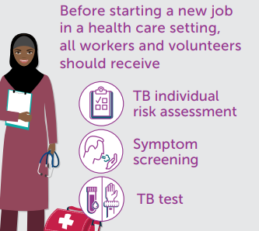
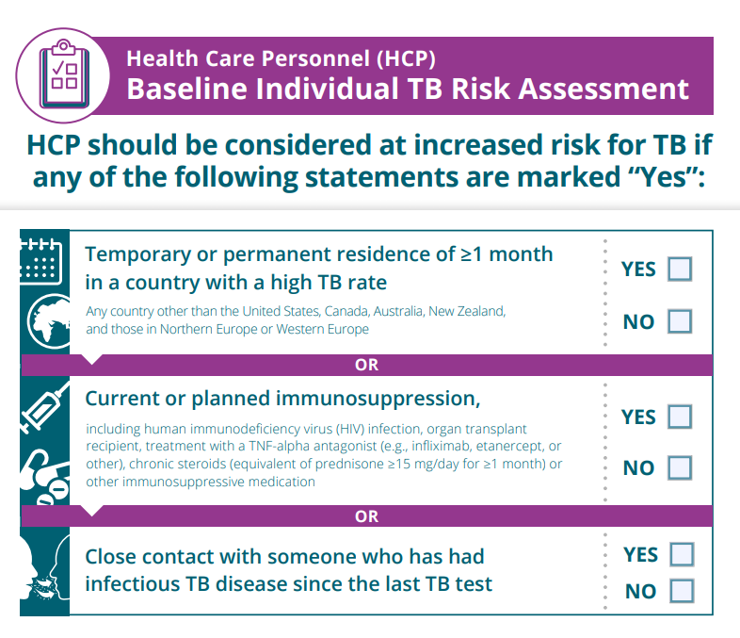
Baseline Preplacement Screening and Testing
Notes:
Prior to staring your position here, you should have had a baseline screening, including an individual risk assessment. This initial screening process would have included someone asking you questions about risks for TB, asking you about any current symptoms, and testing you for TB infection using either a skin test or a blood test. If you had a documented prior positive test for TB infection, someone should still have asked you questions about risk and ask you about symptoms, but you would not need to get another test.
Examples of questions that you might be asked during your risk assessment include if you have spent time in a country with a high rate of TB, if you have current or planned immunosuppression, or if you recently had close contact with someone with TB disease. When thinking about risk, we must consider both an individual’s potential exposures, such as through working with TB patients or travelling to countries with high rates of TB, as well as their risk of progression to active TB disease if infected. Those with current or planned immunosuppression, such as HIV, organ transplant or treatment with chronic steroids, are at a higher risk of progressing from infection to disease.
If you had a new positive test for TB infection or if you reported symptoms of TB, you would have then received a chest x-ray and potential additional evaluation.

Slide 9
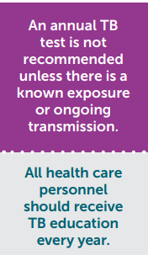
Annual TB Testing
Certain groups of HCP at high risk of TB exposure at work may still be tested annually (e.g., clinicians working in a TB clinic).
You will be notified if you are in one of these groups.

Slide 10
TB Screening/Testing after Exposure
HCP who have an exposure to TB at work will be tested immediately after the exposure and again 8-10 weeks after the exposure.
HCP who have an exposure outside of work should report potential exposure to occupational health and should be tested.
Exposures outside of work could include:
Spending more than 30 days in a country where TB is common
Having close contact with someone with active TB
Working in a healthcare setting in a country where TB is common
Notes:
It is important to notify occupational health of any known exposure to someone with active TB disease. If you are exposed through the workplace, occupational health/infection control will work with the local health department to determine who needs to be tested or evaluated. Individuals without a known previous positive will be tested immediately after exposure and again 8-10 weeks after exposure.
Individuals who have an exposure outside of work would report potential exposure to occupational health and should be tested if they were not previously positive for LTBI. Individuals with new exposure who are previously positive for LTBI will be evaluated but not re-tested.
Explain the process/option for voluntary testing (due to exposure outside of work) at the organization, if available.

Slide 11
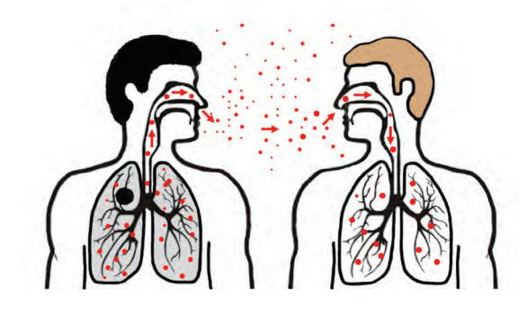
TB Transmission/Exposure
Airborne
M. tuberculosis is carried in airborne particles
When a person who has TB in the lungs or throat coughs, sneezes, shouts or sings, particles are released into the air.
Depending on the environment, TB can remain suspended in the air for several hours.
Transmission/exposure occurs when a person breathes in the bacteria from the air. The bacteria can move from the lungs through the blood to other parts of the body.
TB not in the lungs or throat is not considered infectious.
Notes:
How do you know if you have had an exposure to TB? There are many factors to consider. First, TB is an airborne disease.
TB is NOT spread by shaking someone’s hand, sharing food or drink, touching bed linens or toilet seats.
A person who is exposed to TB bacteria is not able to spread the bacteria to other people right away. Only persons with active TB disease can spread TB bacteria to others. Before you would be able to spread TB to others, you would have to breathe in TB bacteria and become infected. Then the active bacteria would have to multiply in your body and cause active TB disease. At this point, you could possibly spread TB bacteria to others. People with TB disease are most likely to spread the bacteria to people they spend time with every day, such as family members, friends, coworkers.

Slide 12
TB – Probability of Transmission
Many factors impact the probability of transmission of M. tuberculosis:
Susceptibility of the person exposed
Infectiousness of the person with active TB
Environment
Space
Ventilation
Air circulation
Specimen handling
Air pressure
Concentration of infectious droplet nuclei
Exposure
Use of personal protective equipment (PPE)
Proximity
Length
Notes:
Susceptible persons include those with medical conditions or treatments that weaken the immune system

Slide 13

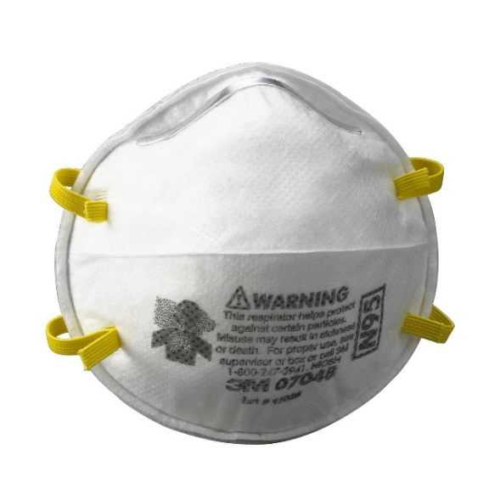


Infection Control
Administrative Controls
Environmental Controls
Respiratory Protection
Notes:
There are 3 levels of Infection Control in place to prevent TB spread:
Administrative controls- organization practices or measures taken that serve to reduce the risk of exposure to persons with infectious TB within the organization setting (for example, minimizing the number of areas where exposure to TB may occur and reducing the risk in those areas where exposure can still occur).
Environmental controls- reduce the concentration of airborne infectious TB droplets in areas where TB exposure can occur.
Respiratory protection -use of respiratory protective equipment in situations that pose a high risk for TB exposure.

Slide 14

Administrative Controls
Implement effective work practices to manage patients who may have TB disease
Test and evaluate HCP at risk for TB exposure
Education and training
This annual education!
Posters/signs about cough etiquette & respiratory hygiene
Notes:
Presenter- make sure to highlight your organization’s administrative controls (completion of your annual facility risk assessment & findings, your policy for managing presumptive/confirmed TB, etc.)
Administrative controls in place for infection control include the implementation of effective work practices to manage patients who may have TB disease, testing and evaluating HCP at risk for exposure, education and training such as this annual education as well as posters/signs about cough etiquette and respiratory hygiene, and our annual facility risk assessment which helps determine the need for airborne isolation rooms.

Slide 15


Environmental Controls
Ventilation
Natural (windows, doors)
Mechanical
Equipment to circulate & move air
Dilution and removal of contaminated air
Airborne isolation rooms (negative pressure)
Cleaning
High efficiency particulate air (HEPA) filters
Ultraviolet germicidal irradiation (UVGI)
Notes:
Presenter – make sure to highlight which environmental controls are used at your facility
Environmental controls are another aspect of infection control in our facility. Environmental controls include ventilation and cleaning.
Additional information:
Airborne isolation rooms have negative pressure relative to other parts of the facility. Negative pressure causes air to flow from the corridors into the room. Air cannot escape to the other parts of the facility when the door is closed and the ventilation system is operating properly. Air from the room can be exhausted directly to the outdoors, where the droplet nuclei will be diluted in the outdoor air, or passed through a special high efficiency air (HEPA) filter that removes most (99.97%) of the droplet nuclei before it is returned to the general circulation.
UVGI is an air cleaning technology that consists of the use of special lamps that give off germicidal ultraviolet irradiation. The lamps are used to inactivate the tubercle bacilli contained in the droplet nuclei. Regular, appropriate maintenance is essential to ensure UVGI lamps are operating correctly.

Slide 16
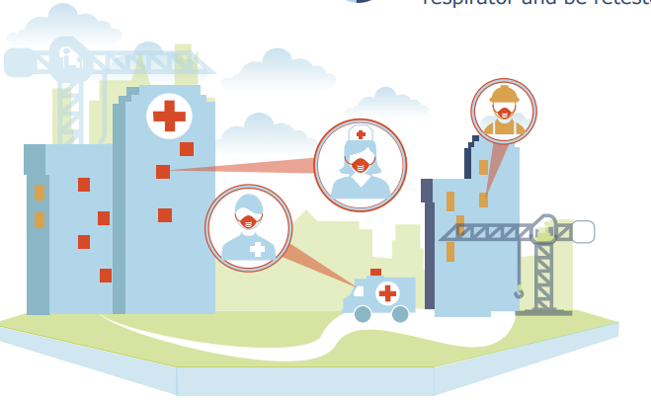

Respiratory Protection
Use of Personal Protective Equipment (PPE)
If you work with TB patients, you will be enrolled in the respiratory protection program and will be medically evaluated and fit-tested annually for an appropriate respirator.
Notes:
Presenter – make sure to highlight what PPE your facility uses, where they are stored, how to get more, when PPE should be used
Respiratory protection is another very important aspect of infection control.
Appropriate use of personal protective equipment (PPE) can reduce the likelihood of exposure to TB
If your role requires you to work with TB patients or in the room of TB patients, you will be enrolled in the respiratory protection program and will be fit-tested for an appropriate N-95 mask.
Wearing a fit-tested N-95 mask will prevent exposure while working with or near a patient with active TB.
The Occupational Safety and Health Administration (OSHA) requires the use of respiratory protection to protect the health of employees during any potential worksite exposure to respiratory hazard(s).
Each employer is required by OSHA (29 CFR 1910.134) to develop and implement a written Respiratory Protection Plan that addresses when and how respiratory protection should be used.
Identify the individual responsible for implementing the organization’s Respiratory Protection Plan. This person is the first contact for employees concerned with respiratory protection.

Slide 17

TB Incubation Period
Weeks
Years
Lifetime
Notes:
If you are exposed to active TB and become infected, some people develop TB disease soon (within weeks) after becoming infected, before their immune system can fight the TB bacteria.
Other people may get sick years later, when their immune system becomes weak or for another reason.
Many people with TB infection never develop TB disease.
About 5-10% of people with LTBI will progress to active disease
80% of people who get sick with TB disease in the United States, get sick from untreated LTBI.

Slide 18
TB Symptoms
Pulmonary TB Disease
Cough
Hemoptysis (blood in cough or sputum)
Unexplained weight loss/loss of appetite
Night sweats
Fever
Fatigue
Extrapulmonary TB Disease
Related to body part affected by the disease
Could also include weight loss, night sweats, fever, fatigue etc.
Notes:
When you were hired, and on an annual basis, you will be asked if you have experienced any TB symptoms. Tuberculosis can impact the lungs, which is referred to as pulmonary TB, or other parts of the body outside of the lungs, referred to as extrapulmonary TB. If you are experiencing these symptoms between annual screenings, you should report them immediately to occupational health for further evaluation.
Pulmonary TB symptoms can include:
Cough
Hemoptysis (blood in cough or sputum)
Unexplained weight loss/loss of appetite
Night sweats
Fever
Fatigue
Symptoms of extra pulmonary TB disease depend on the part of the body that is affected by the disease
TB of the kidney may cause blood in the urine
TB meningitis may cause headache or confusion
TB of the spine may cause back pain
TB of the larynx can cause hoarseness

Slide 19
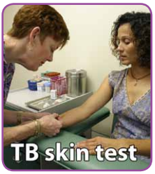
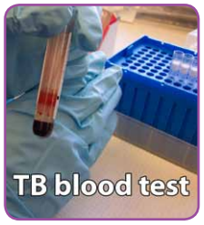
TB Testing and Diagnosis
Two methods for detection of TB infection:
Mantoux tuberculin skin test (TST)
Interferon-gamma release assays (IGRAs)
QuantiFERON-TB Gold Plus (QFT-Plus)
T-SPOT.TB test
Medical history
Physical examination
Chest x-ray
Bacteriologic examination of clinical specimens
Notes:
If there is concern that you have active TB disease, there are several steps to the evaluation. If you don’t have a known previous positive test for TB infection, you would receive another test for TB infection as well as a review of your medical history, a physical examination, chest x-ray and the collection of sputum or other specimens.

Slide 20

TB Testing and Diagnosis
At hire or after an exposure, if you have a positive test for LTBI, you will have a chest x-ray performed to rule out active disease. If your x-ray is normal, LTBI treatment will be offered.
Completing treatment for LTBI means that your infection will not progress to active disease so you will not become sick or make others sick at work or at home.
If you refuse treatment, you will receive an annual symptom review and encouragement to start treatment

Slide 21
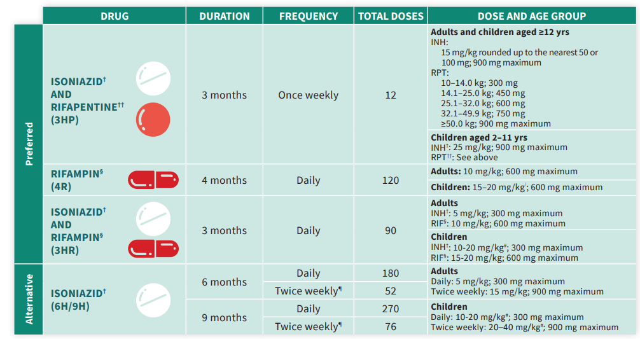
LTBI Treatment
Source: www.cdc.gov/tb/topic/treatment/pdf/LTBITreatmentRegimens.pdf
Notes:
There are several options for LTBI treatment. One option requires taking medication just once per week for twelve weeks.
Presenter: Consider discussing treatment options through the workplace or if the workplace expects employees to seek treatment through their personal doctor.

Slide 22
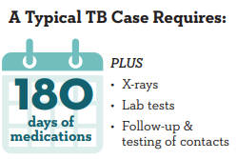
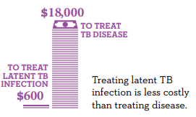
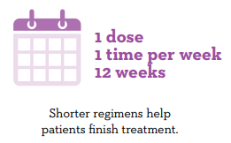
Financial and Personal Cost of LTBI vs. TB
A Typical LTBI Case Requires:
Notes:
There are several short course options for treating LTBI, which will prevent progression to TB disease. Preventing TB disease means both that the person with LTBI won’t get sick and that they won’t expose others to TB at work or at home. Active disease takes longer to treat and requires people to limit their activities and can impact others in their family or at work. Treating LTBI is also much less expensive than treating active TB disease.

Slide 23
Risk Factors
Certain medical conditions and risk factors make it more likely that an individual will progress from LTBI to TB disease:
HIV infection
Substance abuse
Silicosis
Diabetes mellitus
Severe kidney disease
Low body weight
Organ transplants
Head and neck cancer
Medical treatments such as corticosteroids or organ transplant
Specialized treatment for rheumatoid arthritis or Crohn’s disease

Slide 24
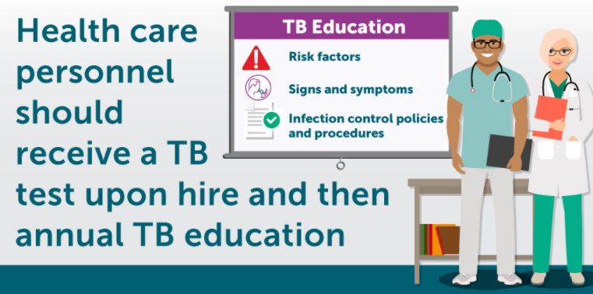
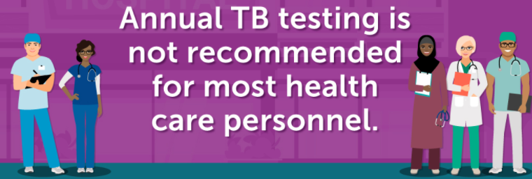
Key Points

Slide 25
Questions?

